Slide 1


Day 7: Managing Account Master Data
Maintain FS items and GL account mapping

Slide 2

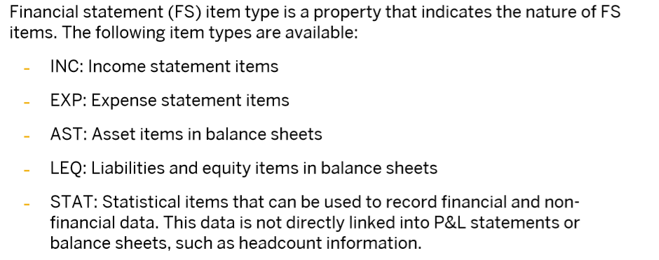
Mapping FS items to GL accounts

Slide 3
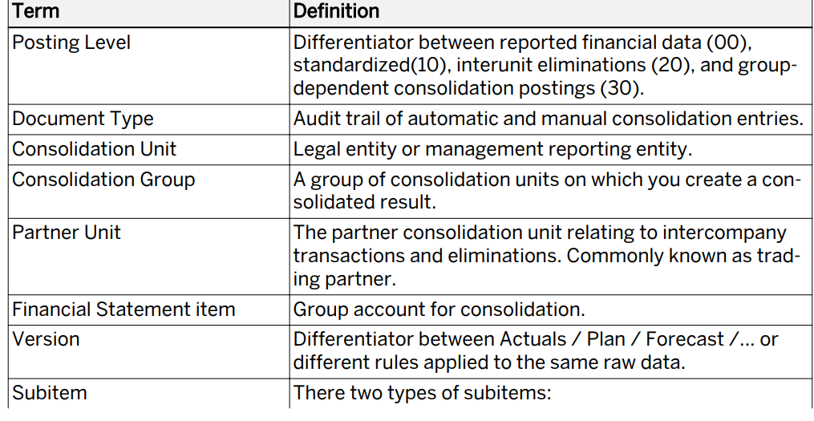

Slide 4
